Slide 1

Chapter 4:
Project Integration Management
Information Technology Project Management, Seventh Edition
Note: See the text itself for full citations.

Slide 2
Learning Objectives
Describe an overall framework for project integration management as it relates to the other project management knowledge areas and the project life cycle
Discuss the strategic planning process and apply different project selection methods
Explain the importance of creating a project charter to formally initiate projects
Describe project management plan development, understand the content of these plans, and review approaches for creating them

Slide 3
Learning Objectives
Explain project execution, its relationship to project planning, the factors related to successful results, and tools and techniques to assist in directing and managing project work
Describe the process of monitoring and controlling a project
Understand the integrated change control process, planning for and managing changes on information technology (IT) projects, and developing and using a change control system
Explain the importance of developing and following good procedures for closing projects
Describe how software can assist in project integration management

Slide 4
Project Integration Management Processes
1. Developing the project charter involves working with stakeholders to create the document that formally authorizes a project—the charter.
2. Developing the project management plan involves coordinating all planning efforts to create a consistent, coherent document—the project management plan.
3. Directing and managing project work involves carrying out the project management plan by performing the activities included in it.

Slide 5
Project Integration Management Processes (cont’d)
Monitoring and controlling project work involves overseeing activities to meet the performance objectives of the project
Performing integrated change control involves identifying, evaluating, and managing changes throughout the project life cycle.
Closing the project or phase involves finalizing all activities to formally close the project or phase.

Slide 6
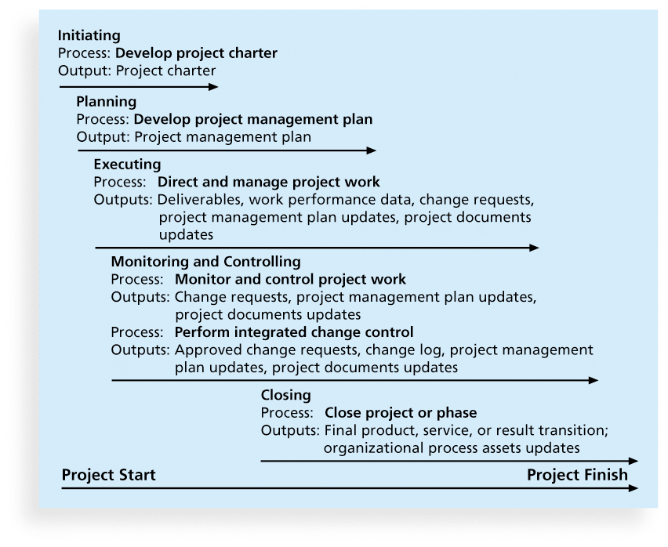
Figure 4-1. Project Integration Management Summary

Slide 7
Strategic Planning and Project Selection
Strategic planning involves determining long-term objectives, predicting future trends, and projecting the need for new products and services
Organizations often perform a SWOT analysis
  analyzing Strengths, Weaknesses, Opportunities, and Threats
As part of strategic planning, organizations
  identify potential projects
  use realistic methods to select which projects to work on
  formalize project initiation by issuing a project charter

Slide 8
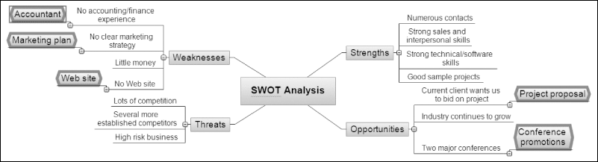
Figure 4-2. Mind Map of a SWOT Analysis to Help Identify Potential Projects

Slide 9
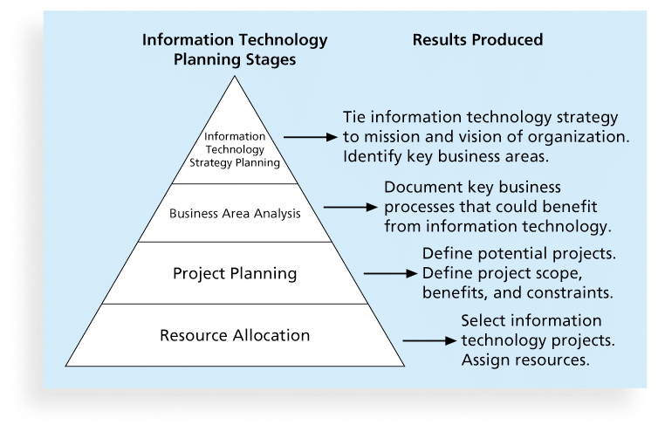
Figure 4-3. Information Technology Planning Process

Slide 10
Best Practice
Only one in seven product concepts comes to fruition. Why is it that some companies, like Proctor & Gamble, Johnson and Johnson, Hewlett Packard, and Sony are consistently successful in NPD? Because they use a disciplined, systematic approach to NPD projects based on best practices
Four important forces behind NPD success include the following:
  A product innovation and technology strategy for the business
  Resource commitment and focusing on the right projects, or solid portfolio management
  An effective, flexible and streamlined idea-to-launch process
  The right climate and culture for innovation, true cross-functional teams, and senior management commitment to NPD

Slide 11
Methods for Selecting Projects
There are usually more projects than available time and resources to implement them
Methods for selecting projects include:
  focusing on broad organizational needs
  categorizing information technology projects
  performing net present value or other financial analyses
  using a weighted scoring model
  implementing a balanced scorecard

Slide 12
Focusing on Broad
Organizational Needs
It is often difficult to provide strong justification for many IT projects, but everyone agrees they have a high value
“It is better to measure gold roughly than to count pennies precisely”
Three important criteria for projects:
  There is a need for the project
  There are funds available
  There’s a strong will to make the project succeed

Slide 13
Categorizing IT Projects
One categorization is whether the project addresses
  a problem
  an opportunity, or
  a directive
Another categorization is how long it will take to do and when it is needed
Another is the overall priority of the project

Slide 14
Financial Analysis of Projects
Financial considerations are often an important consideration in selecting projects
Three primary methods for determining the projected financial value of projects:
  Net present value (NPV) analysis
  Return on investment (ROI)
  Payback analysis

Slide 15
Net Present Value Analysis
Net present value (NPV) analysis is a method of calculating the expected net monetary gain or loss from a project by discounting all expected future cash inflows and outflows to the present point in time
Projects with a positive NPV should be considered if financial value is a key criterion
The higher the NPV, the better

Slide 16
净现值=未来报酬总现值-建设投资总额
NPV=∑(CI-CO)/(1+i)**t
其中：CI-第t年的现金流入量；CO-第t年的现金流出量；i-折现率；t-计算年限；n-投资项目的寿命周期
n

Slide 17
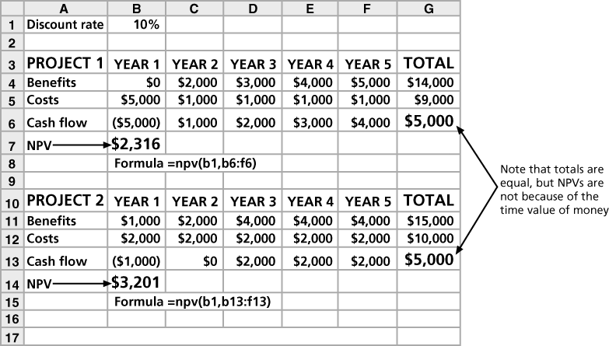
Figure 4-4. Net Present Value Example

Slide 18
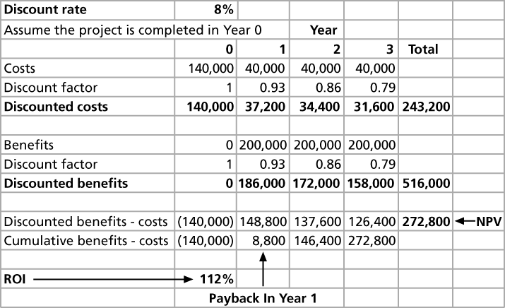
Figure 4-5. JWD Consulting NPV Example
Note: See the template called business_case_financials.xls

Slide 19
NPV Calculations
Determine estimated costs and benefits for the life of the project and the products it produces
Determine the discount rate (check with your organization on what to use)
Calculate the NPV (see text for details)
Notes: Some organizations consider the investment year as year 0, while others start in year 1. Some people entered costs as negative numbers, while others do not. Check with your organization for their preferences

Slide 20
Return on Investment
Return on investment (ROI) is calculated by subtracting the project costs from the benefits and then dividing by the costs
  ROI = (total discounted benefits - total discounted costs) / discounted costs
The higher the ROI, the better
Many organizations have a required rate of return or minimum acceptable rate of return on investment for projects
Internal rate of return (IRR) can by calculated by finding the discount rate that makes the NPV equal to zero

Slide 21
Payback Analysis
Another important financial consideration is payback analysis
The payback period is the amount of time it will take to recoup, in the form of net cash inflows, the total dollars invested in a project
Payback occurs when the net cumulative discounted benefits equals the costs
Many organizations want IT projects to have a fairly short payback period

Slide 22
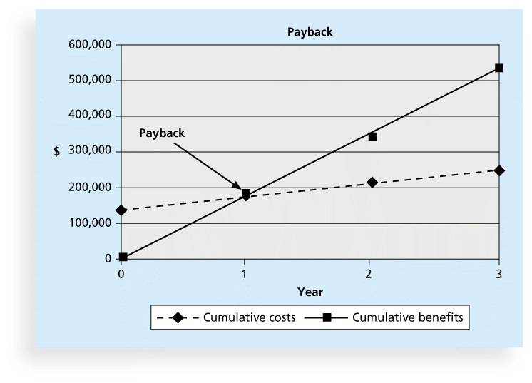
Figure 4-6. Charting the Payback Period

Slide 23
Weighted Scoring Model
A weighted scoring model is a tool that provides a systematic process for selecting projects based on many criteria
    Identify criteria important to the project selection process
    Assign weights (percentages) to each criterion so they add up to 100%
    Assign scores to each criterion for each project
    Multiply the scores by the weights and get the total weighted scores
The higher the weighted score, the better

Slide 24
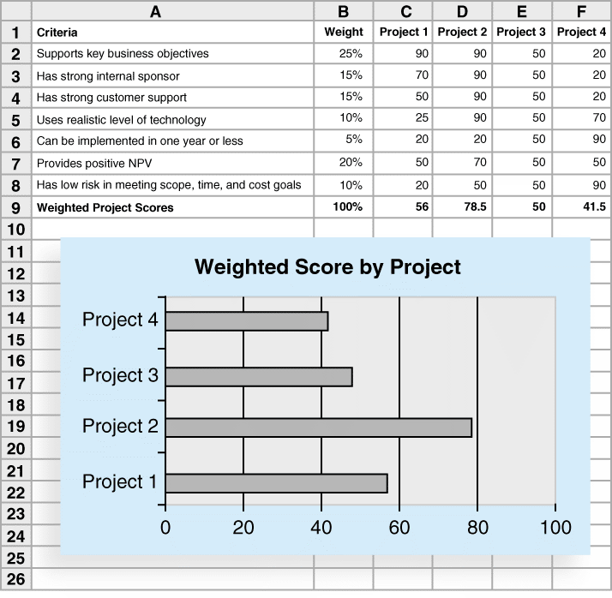
Figure 4-7. Sample Weighted Scoring Model for Project Selection

Slide 25
Implementing a Balanced Scorecard
Drs. Robert Kaplan and David Norton developed this approach to help select and manage projects that align with business strategy
A balanced scorecard
  is a methodology that converts an organization’s value drivers, such as customer service, innovation, operational efficiency, and financial performance, to a series of defined metrics
See www.balancedscorecard.org for more information

Slide 26
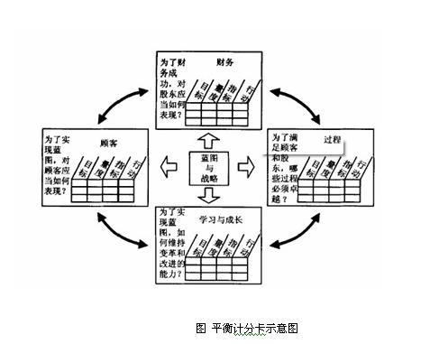
通过四项指标的衡量，企业一方面保留传统上衡量过去绩效的财务指标，并且兼顾了促成财务目标的绩效因素之衡量；在支持组织追求业绩之余，也监督组织的行为应兼顾学习与成长的面向，并且透过一连串的互动因果关系，组织得以把产出（Outcome）和绩效驱动因素（Performance Driver）串联起来，以衡量指标与其量度做为语言，把组织的使命和策略转变为一套前后连贯的系统绩效评核量度，把复杂而笼统的概念转化为精确的目标，藉以寻求财务与非财务的衡量之间、短期与长期的目标之间、落后的与领先的指标之间，以及外部与内部绩效之间的平衡。

Slide 27
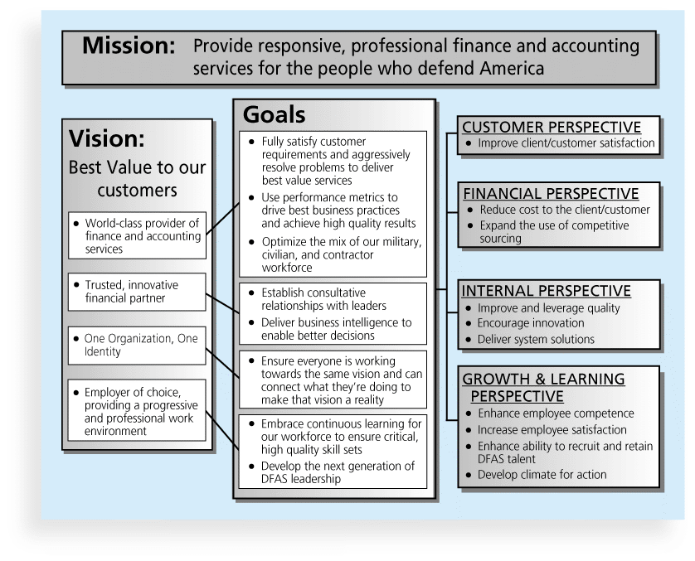
Figure 4-8. Balanced Scorecard Example

Slide 28
Inputs for Developing a Project Charter
A project statement of work
A business case
Agreements
Enterprise environmental factors
Organizational process assets, which include formal and informal plans, policies, procedures, guidelines, information systems, financial systems, management systems, lessons learned, and historical information

Slide 29
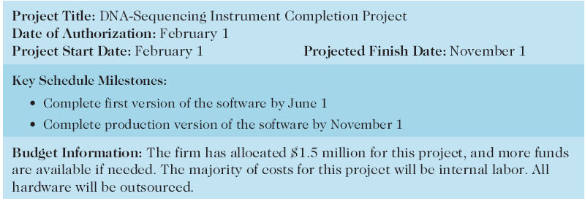
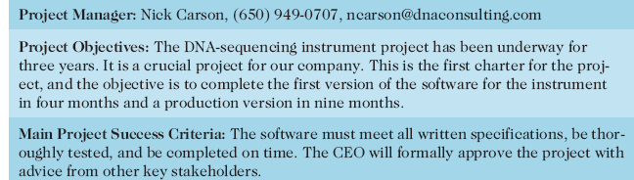
Table 4-1. Project Charter for the DNA-Sequencing Instrument Completion Project

Slide 30
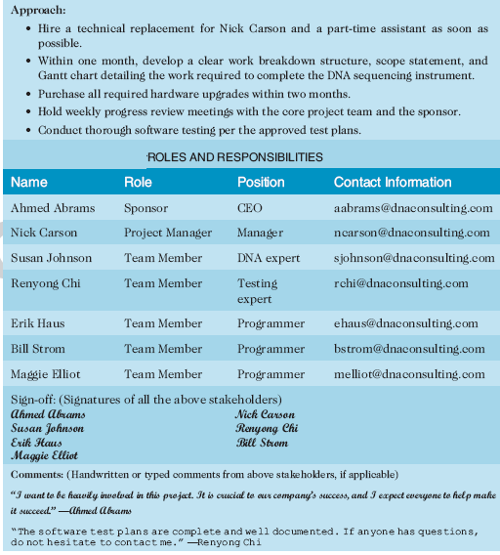
Table 4-1. Project Charter (cont.)

Slide 31
Developing a Project Management Plan
A project management plan is a document used to coordinate all project planning documents and help guide a project’s execution and control
Plans created in the other knowledge areas are subsidiary parts of the overall project management plan

Slide 32
Common Elements of a Project Management Plan
Introduction or overview of the project
Description of how the project is organized
Management and technical processes used on the project
Work to be done, schedule, and budget information

Slide 33
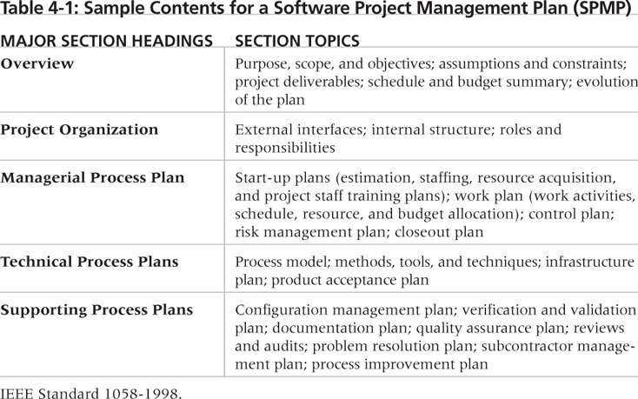
Table 4-2. Sample Contents for a Software Project Management Plan (SPMP)

Slide 34
Monitoring and Controlling Project Work
Changes are inevitable on most projects, so it’s important to develop and follow a process to monitor and control changes
Monitoring project work includes collecting, measuring, and disseminating performance information
A baseline is the approved project management plan plus approved changes

Slide 35
Performing Integrated Change Control
Three main objectives are:
  Influencing the factors that create changes to ensure that changes are beneficial
  Determining that a change has occurred
  Managing actual changes as they occur

Slide 36
Change Control on Information Technology Projects
Former view: The project team should strive to do exactly what was planned on time and within budget
Problem: Stakeholders rarely agreed up-front on the project scope, and time and cost estimates were inaccurate
Modern view: Project management is a process of constant communication and negotiation
Solution: Changes are often beneficial, and the project team should plan for them

Slide 37
Change Control System
A change control system is a formal, documented process that describes when and how official project documents and work may be changed
Describes who is authorized to make changes and how to make them

Slide 38
Change Control Board (CCB)
A change control board is a formal group of people responsible for approving or rejecting changes on a project
CCBs provide guidelines for preparing change requests, evaluate change requests, and manage the implementation of approved changes
Includes stakeholders from the entire organization

Slide 39
Making Timely Changes
Some CCBs only meet occasionally, so it may take too long for changes to occur
Some organizations have policies in place for time-sensitive changes
  “48-hour policy” allows project team members to make decisions, then they have 48 hours to reverse the decision pending senior management approval
  Delegate changes to the lowest level possible, but keep everyone informed of changes

Slide 40
Configuration Management
Configuration management ensures that the descriptions of the project’s products are correct and complete
Involves identifying and controlling the functional and physical design characteristics of products and their support documentation
Configuration management specialists identify and document configuration requirements, control changes, record and report changes, and audit the products to verify conformance to requirements
See www.icmhq.com for more information

Slide 41
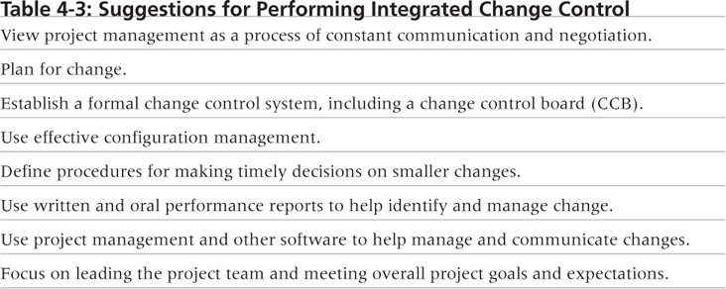
Table 4-3. Suggestions for Performing Integrated Change Control

Slide 42
Closing Projects or Phases
To close a project or phase, you must finalize all activities and transfer the completed or cancelled work to the appropriate people
Main outputs include
  Final product, service, or result transition
  Organizational process asset updates

Slide 43
Using Software to Assist in Project Integration Management
Several types of software can be used to assist in project integration management
  Documents can be created with word processing software
  Presentations are created with presentation software
  Tracking can be done with spreadsheets or databases
  Communication software like e-mail and Web authoring tools facilitate communications
  Project management software can pull everything together and show detailed and summarized information
  Business Service Management (BSM) tools track the execution of business process flows

Slide 44
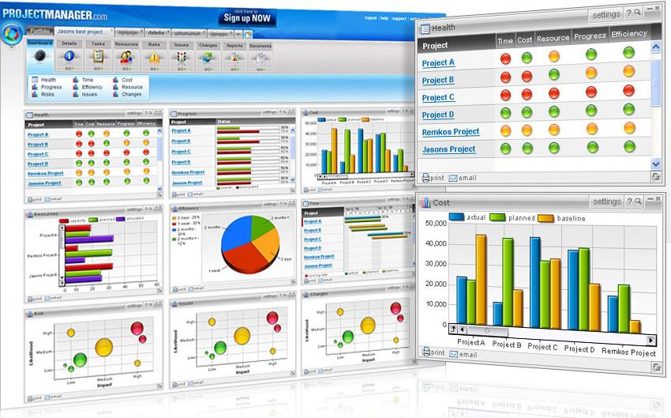
Figure 4-9. Sample Portfolio Management Software Screen
Source: www.projectmanager.com

Slide 45
Chapter Summary
Project integration management involves coordinating all of the other knowledge areas throughout a project’s life cycle
Main processes include
  Develop the project charter
  Develop the project management plan
  Direct and manage project execution
  Monitor and control project work
  Perform integrated change control
  Close the project or phase

